Slide 1
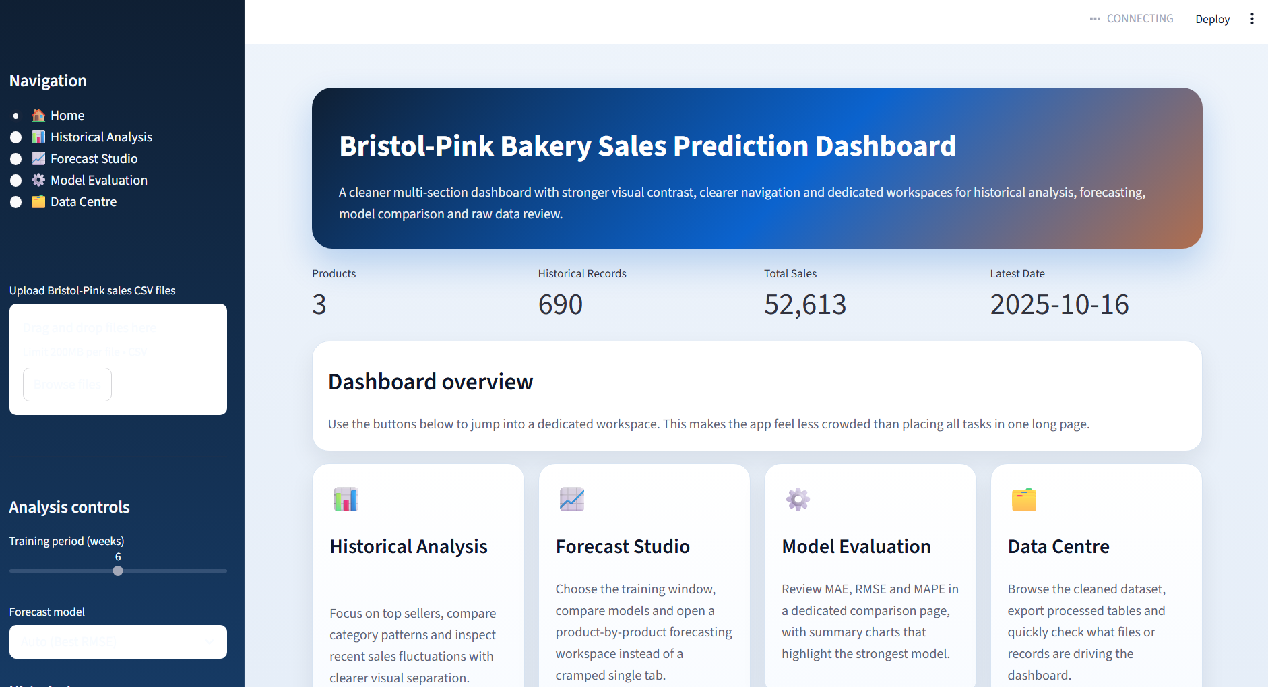
Bristol-Pink
Bakery Sales
Prediction
Dashboard
Historical analysis, 4-week forecasting and model evaluation in one integrated Streamlit application.
Notes:
[Sources] - User-provided screenshot: 700f89e5-79bb-4162-a031-8fd301a68f7a.png

Slide 2
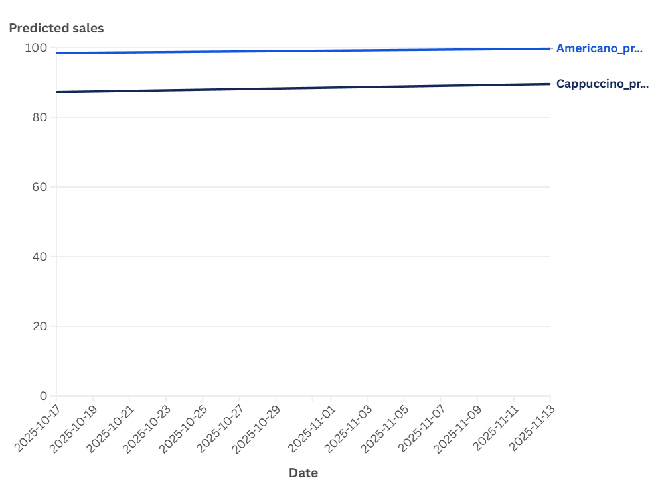
BUSINESS CONTEXT
Why this project matters
Business problem
Operational value
Bakery and café products are perishable, so overproduction immediately turns into waste and avoidable cost.
Demand changes by day, by product and by short-term trend, which makes manual planning unreliable.
Managers need one place to review the recent sales pattern, compare products and inspect a short forecast.
The project therefore focuses on turning raw sales files into decisions about preparation and stocking.
Forecast-led planning can reduce overproduction.
Historical fluctuations make staffing and purchasing easier to justify.
Evaluation metrics make the forecast more trustworthy than a black-box output.
Notes:
[Sources] - User-provided chart: 6ad685f36be9e73701a63740902f610f.png

Slide 3
PROJECT SCOPE
Objectives and key deliverables
1. CSV ingestion
2. Historical analysis
3. 4-week forecast
4. Evaluation
Read uploaded food and coffee sales files and merge them into one analysis-ready dataset.
Show top products, trends and fluctuations in both chart and table formats.
Generate a short-term forecast and allow users to inspect a selected forecast window.
Compare models using MAE, RMSE and MAPE rather than relying on one unsupported output.
Why the final structure works
Dashboard workflow
Separate workspaces avoid the clutter of a single long dashboard page.
The same dataset can be reused for analysis, forecasting, evaluation and export.
This structure also makes the live presentation easier because each person can explain one clear module.
Upload → Clean → Explore → Forecast → Evaluate → Export
This end-to-end flow is the main story of the project and the easiest way to explain team contributions.
Notes:
[Sources] - Project structure based on user-provided brief and dashboard implementation.

Slide 4
2. System Architect

Slide 5
Team Roles and Collaboration
Yu Yunze : Business background
Cheng Jilong : System Architecture
Xie Jiaqi: Front-end development; building the Streamlit interface
Nader – Back-end Development
Yang Haodong – Testing & Evaluation

Slide 6
TECHNICAL DESIGN
System architecture and data flow
It runs in a Streamlit application, with a clear separation between the UI, data processing, visualization, and evaluation modules.
UI layer
Back-end logic
Visualisation layer
Model & evaluation
Layout, navigation, controls and page rendering.
CSV ingestion, cleaning and daily-series preparation.
Historical, forecast and comparison charts.
Forecast generation, error calculation and model selection.
How data moves through the app
1
CSV files are uploaded through the sidebar and passed into the loading function.
2
The files are cleaned, converted into a unified structure and filtered by date range.
3
The cleaned data is reused for charts, forecasts, KPI cards and export views.
Frontend
Data
Charts
ML
State
Streamlit + custom CSS
Pandas / NumPy
Plotly
scikit-learn
session_state
Notes:
[Sources] - System architecture based on user-provided Bristol-Pink_improved.py implementation.

Slide 7
3.Front-end Developer

Slide 8
TEAM STRUCTURE
How the work was divided across the group
1. Research and requirements
Interpreting the brief, defining scope, identifying goals and preparing the project narrative.
2. Front-end UI
Designing navigation, controls, page layout and user interaction flow.
3. Back-end processing
Loading, cleaning, merging and filtering different CSV structures.
4. Data visualisation
Building charts and choosing how results are presented clearly.
5. Model evaluation and integration
Comparing models, testing outputs and connecting the workflow end to end.
Notes:
[Sources] - Team-role summary based on user-stated presentation plan and dashboard modules.

Slide 9
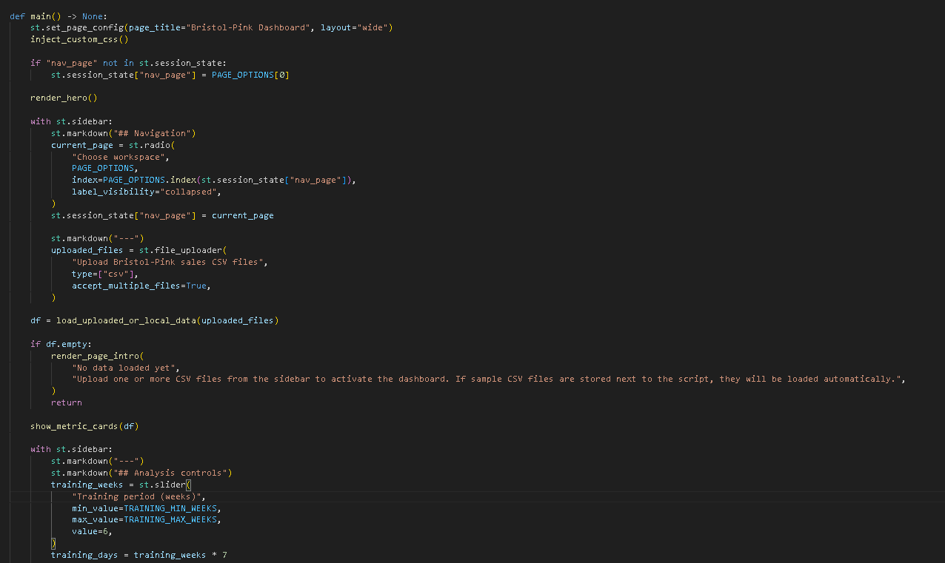
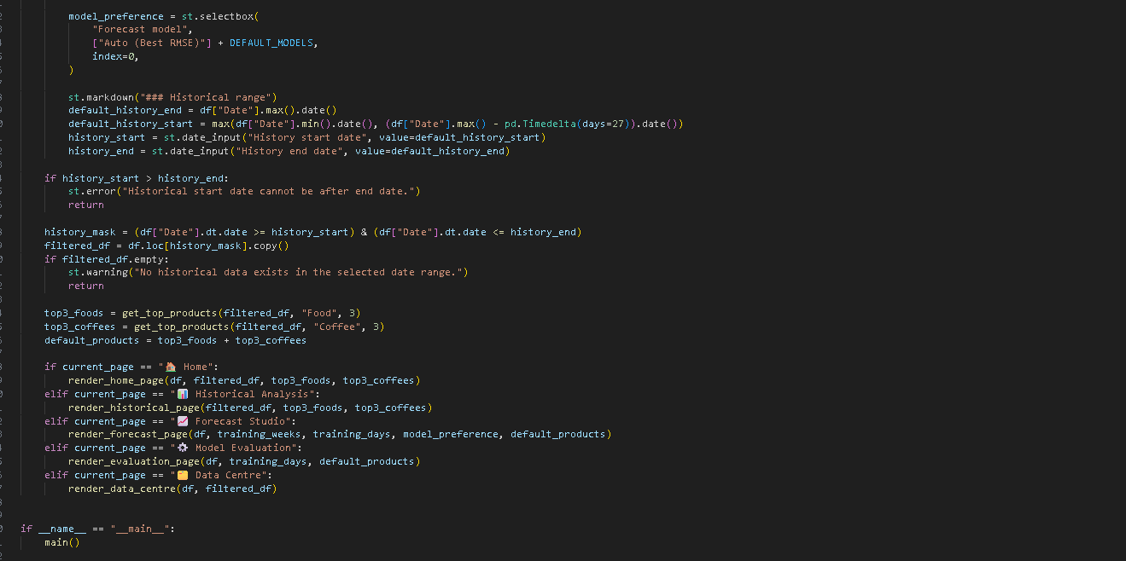
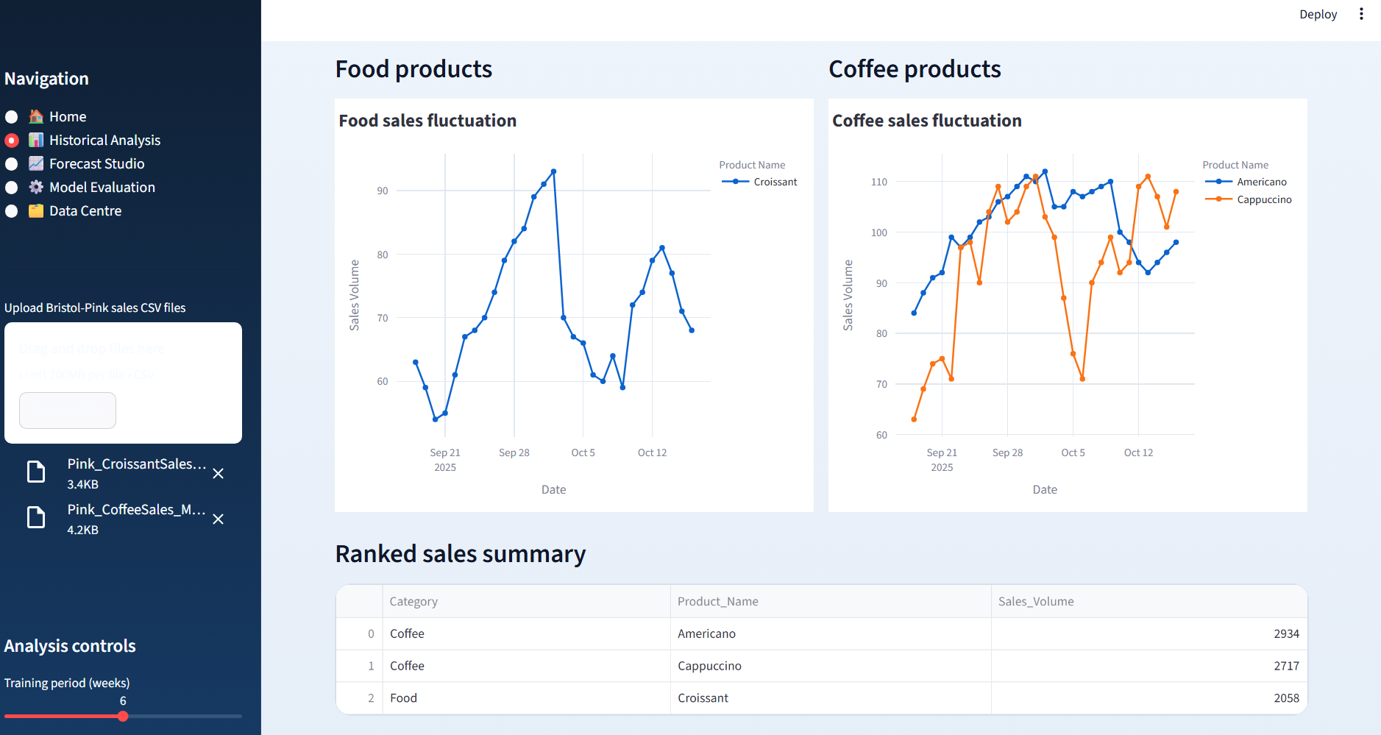
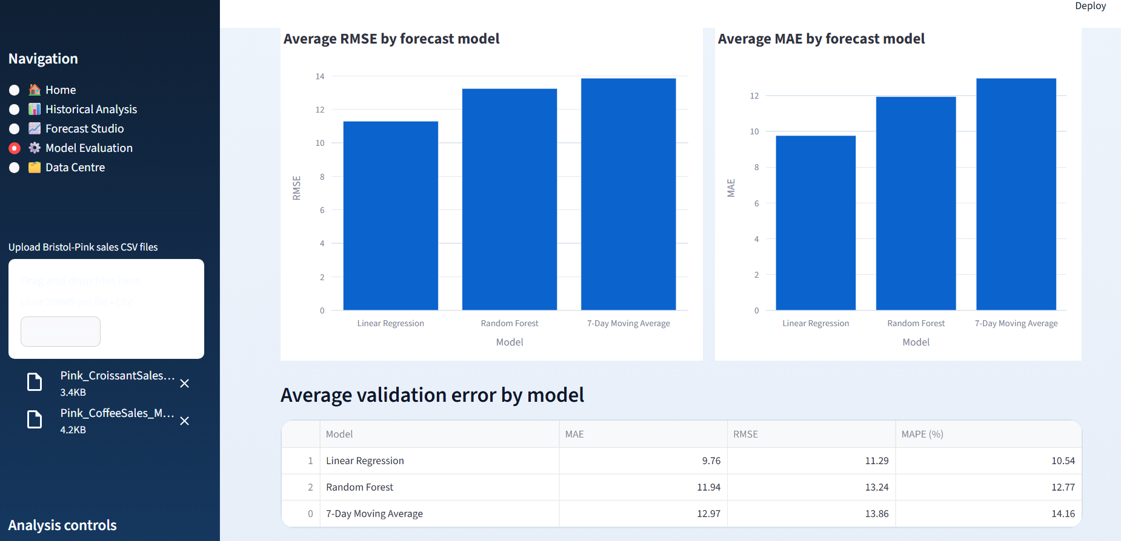
UI SUPPORT
Front-end UI and interaction design
The interface is supported by page logic and controls in code, not only by the final screenshots.
Running interface
UI evidence in code
What this shows
Sidebar routing and workspace switching
CSV upload, model selection and date controls
Basic validation and page-specific rendering
Notes:
[Sources] - User-provided screenshots: 700f89e5-79bb-4162-a031-8fd301a68f7a.png, 0ad79ae4-e15d-4d9f-a2ad-4f4cc3d96666.png, a22f29c5-3fd3-476c-bb66-13681e06374a.png - User-provided UI code screenshots: 8af83a7176be867ff15ceb4a4d58ed61.png, 6fe0d813448847991ddbef40375874ba.png

Slide 10
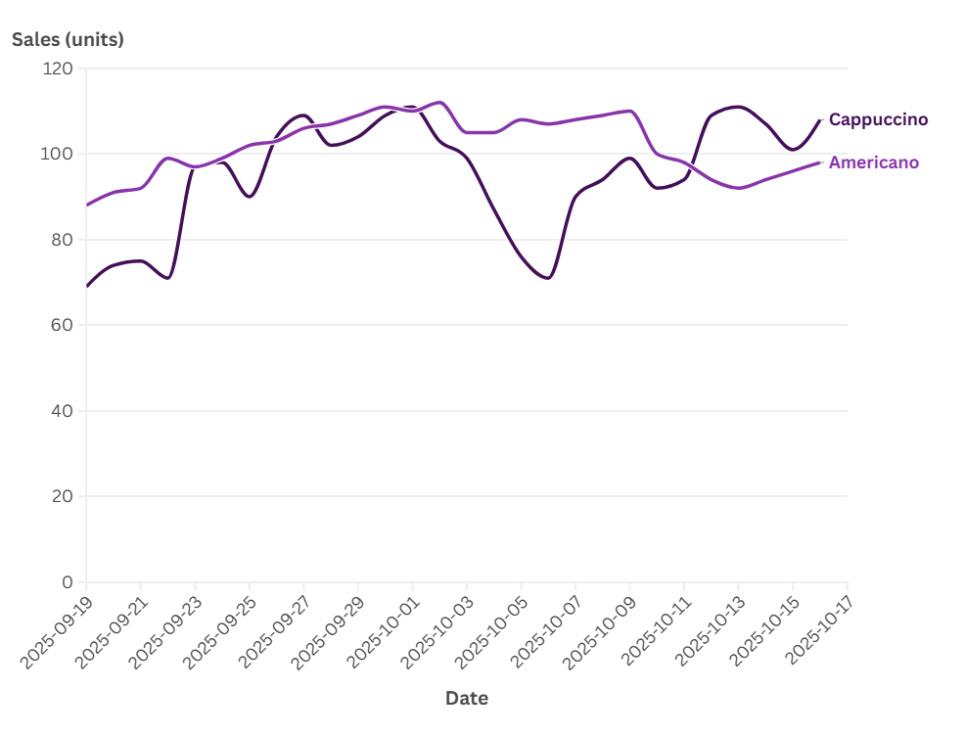
HISTORICAL ANALYSIS
What the dashboard reveals from historical sales
The historical workspace turns the cleaned dataset into product comparisons, ranked summaries and short-term pattern detection.
Historical analysis with two CSV files loaded
Interpretation points
Food and coffee are shown in separate sections, which reduces clutter and makes product behaviour easier to compare.
The ranked sales summary quickly identifies the strongest items in the active history range.
Pattern example
A focused comparison of Americano and Cappuccino helps explain why users need both trend views and product selection controls.
Notes:
[Sources] - User-provided screenshots: 0ad79ae4-e15d-4d9f-a2ad-4f4cc3d96666.png, c87d241bc10807160df913fce5e9c6fa.png

Slide 11
4.Back-end / Data Scientist

Slide 12
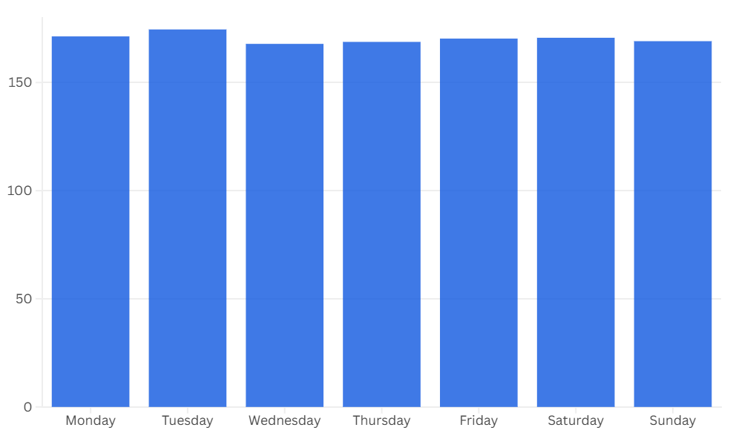
VISUALISATION SUPPORT
How the chart layer improves interpretation
Historical trend chart
Weekly pattern chart
Visualisation role
Line charts explain movement over time.
Bar charts explain comparison and distribution.
Graph, table or both modes support different user preferences.
Forecast shading makes the prediction window immediately visible.
This kind of line chart helps the user compare the stability and fluctuation of two products over the same period.
A weekday distribution provides a different view of demand by summarising repeated weekly behaviour rather than only showing a raw time series.
Notes:
[Sources] - User-provided charts: c87d241bc10807160df913fce5e9c6fa.png, 93eaeb84519916564957ae10c906f315.png

Slide 13
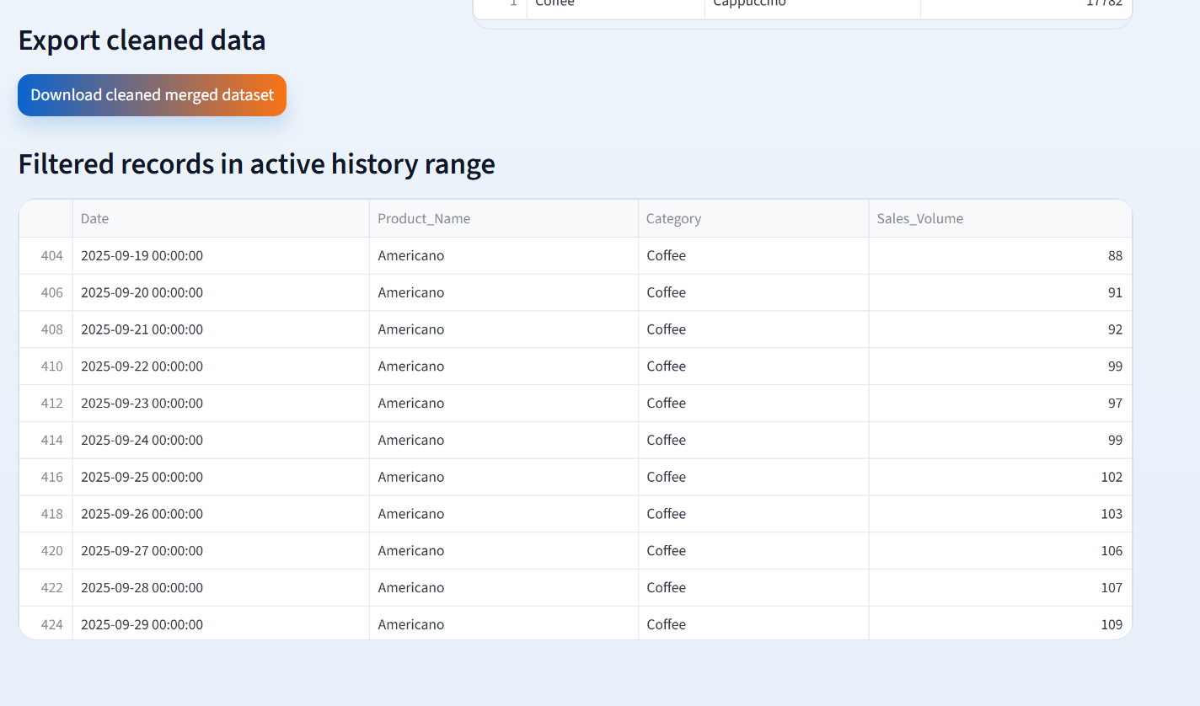
BACK-END SUPPORT
CSV ingestion and preprocessing pipeline
Back-end process
Code evidence
Why it matters
The system accepts two different CSV structures rather than one perfectly uniform input.
The coffee file is converted from a wide layout into a long table using a melt step.
The food file is renamed and enriched with Product_Name so both sources share the same schema.
After cleaning, both files are merged, sorted and filtered before any chart or forecast is created.
After preprocessing, the cleaned records are available in the Data Centre page for inspection and export.
A forecast is only credible if the input data is consistent.
Showing preprocessing evidence makes the back-end contribution concrete.
This also explains how one uploaded dataset can feed multiple pages in the app.
Separate VS Code testing was also used to confirm that the same pipeline could correctly parse and unify the two source files before the dashboard used them.
Key output:
Date + Product_Name + Category + Sales_Volume
Notes:
[Sources] - User-provided screenshot: 9e3ba6ba-16af-4498-818a-11701a444e90.png - Back-end explanation based on user-provided Bristol-Pink_improved.py and separate test workflow discussed in chat.

Slide 14
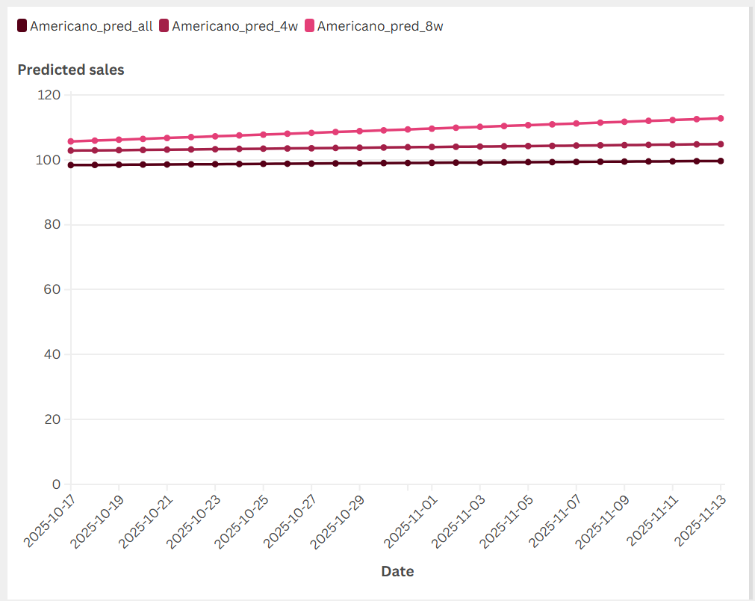
FORECASTING LOGIC
From training window to 4-week output
The forecast page combines user controls, model output and forecast KPIs in one workspace.
Forecast Studio
Training-window effect
How to explain it
Users can change the training period instead of relying on one fixed history range.
The page shows actual sales, predicted sales and model metrics at the same time.
This makes the forecast easier to trust and easier to discuss during the demo.
Notes:
[Sources] - User-provided screenshots: a22f29c5-3fd3-476c-bb66-13681e06374a.png, 3e8bbecc460ad2918d188aff6b73c778.png

Slide 15
5.QA & Evaluation

Slide 16
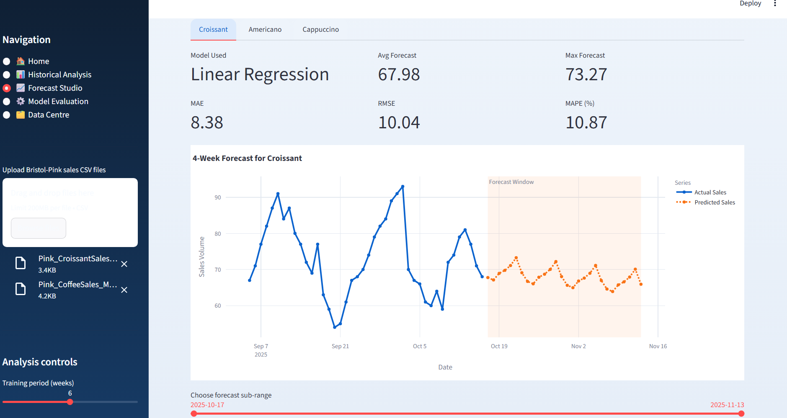
MODEL EVALUATION
Why the forecast is credible
Evaluation workspace
Key message
Linear Regression performs best on this dataset because its average RMSE and MAE are lowest.
Random Forest remains useful, but it is less accurate here.
The 7-day moving average acts as a baseline reference rather than the final choice.
Presentation line
We compare models before choosing the forecast.
This single sentence is useful in the presentation because it turns evaluation into a clear reason for trust.
Notes:
[Sources] - User-provided screenshot: bceb599a-3bee-4205-8c0f-608ad8873887.png

Slide 17
DATA TRANSPARENCY
How processed data appears inside the dashboard
The app does not hide its input records; it also allows users to inspect and export the cleaned dataset.
Data Centre page
Why this matters
Users can confirm what rows are included in the active history range.
The export option shows that the cleaned dataset is not hidden inside the code.
This supports reproducibility because the same processed table can be checked outside the app.
For the presentation, it proves that KPI cards and charts are backed by visible records.
Visible data makes the dashboard more trustworthy.
Notes:
[Sources] - User-provided screenshot: 9e3ba6ba-16af-4498-818a-11701a444e90.png

Slide 18
CONCLUSION
Bringing the technical and business stories together
Final summary
System snapshots
The dashboard turns uploaded sales files into a complete workflow: clean data, analyse history, forecast demand, compare models and export results.
The interface is modular, so each team member can explain one clear section without losing the overall story.
UI evidence, back-end validation and visualisation logic make the system feel concrete instead of lightweight.
A logical next step would be adding external variables such as weather, promotions or holidays to improve prediction quality.
Thank you.
Notes:
[Sources] - User-provided screenshots: 700f89e5-79bb-4162-a031-8fd301a68f7a.png, a22f29c5-3fd3-476c-bb66-13681e06374a.png, bceb599a-3bee-4205-8c0f-608ad8873887.png

Slide 19
Thank you for listening

